Slide 1
PRESIDENT’S REPORT FY 2016-2017 Isabelo P. Africa
PSHS Foundation Inc. 2017

Slide 2
PSHFI @ 40
TOTAL FUND BALANCE:
P46.6M
PSHFI @ 25
TOTAL FUND BALANCE:
P23.9M
PSHS Foundation Inc. 2017

Slide 3
PSHS Foundation, Inc.
PURPOSE
To maintain educational excellence by bridging the gap between available government funds and the actual financial requirements needed by the school.
PSHS Foundation Inc. 2017

Slide 4
GODPARENT PROGRAM
PSHS Foundation Inc. 2017

Slide 5
GODPARENT PROGRAM
AY 2016-2017
GODCHILDREN : 98
(in college) : 10
GODPARENTS : 67
Monthly Stipend : P2,000.00 – P5,000.00
TOTAL FUND REQUIREMENT
: P2,680,000.00
PSHS Foundation Inc. 2017

Slide 6
GODPARENT PROGRAM
Godchildren Merit Awards
SY | No. of Recipients | Amount Disbursed
2007-2008 | 15 | 22,500.00
2008-2009 | 18 | 27,000.00
2009-2010 | 14 | 21,000.00
2010-2011 | 15 | 22,500.00
2011-2012 | 27 | 47,500.00
2012-2013 | 29 | 47,000.00
2013-2014 | 30 | 48,500.00
2014-2015 | 33 | 56,500.00
2015-2016 | 31 | 46,500.00
2016-2017 | 63 | 69,000.00
Total | 275 | 408,000.00
Merit Awards
SY | No. of Recipients | Amount Disbursed
2007-2008 | 15 | 22,500.00
2008-2009 | 18 | 27,000.00
2009-2010 | 14 | 21,000.00
2010-2011 | 15 | 22,500.00
2011-2012 | 27 | 47,500.00
2012-2013 | 29 | 47,000.00
2013-2014 | 30 | 48,500.00
2014-2015 | 33 | 56,500.00
2015-2016 | 31 | 46,500.00
2016-2017 | 63 | 69,000.00
Total | 275 | 408,000.00
PSHS Foundation Inc. 2017

Slide 7
Main Campus
GODPARENT PROGRAM
Powered By: Parents, Alumni and Corporations
Godchildren Care Fund (GCF) SY 2016-17
P1,363,028.00
PSHS Foundation Inc. 2017

Slide 8
GODPARENT PROGRAM
Powered By: Parents, Alumni and Corporations
Godchildren Care Fund (GCF)
“The GCF is intended to address special needs of the godchildren and for that matter, any other PSHS student needing assistance, particularly to address academic and health concerns and corollarily for participation in major co-curricular activities. Only PSHS recommended appeals for assistance shall be considered for funding. Assistance shall be provided upon Board en banc approval.”
PSHS Foundation Inc. 2017

Slide 9
GODPARENT PROGRAM
Assistance for Participation in Conferences and Competitions
1 | Leadership Camp: IOS 10 Ignite. Optimize. Synergize on May 3 to 4, 2016 at Timberland Sports and Nature Club | Regala, John Daniel | P4,650.
3 | International Olympiad in Informatics/IOI 2016, Kaza, Tatarstan, Russia on August 12 to 19, 2016 | Batara, Maded N. III | P10,000.
2 | MyTRIZ Fiesta (Workshop, Conference, competition) 2016 on November 23-26, 2016 at Taylor's University Lakeside Campus, KL | Opulencia, Justine Marcus | P11,620.
4 | Re-Inventing Japan Project by Kyushu University in Fukuoka City, Fukuoka, Japan on February 17-20, 2017 | Torio, Ericka Marie B. | P7,770.
 |  | Total | P34,040.
Merit Awards
SY | No. of Recipients | Amount Disbursed
2007-2008 | 15 | 22,500.00
2008-2009 | 18 | 27,000.00
2009-2010 | 14 | 21,000.00
2010-2011 | 15 | 22,500.00
2011-2012 | 27 | 47,500.00
2012-2013 | 29 | 47,000.00
2013-2014 | 30 | 48,500.00
2014-2015 | 33 | 56,500.00
2015-2016 | 31 | 46,500.00
2016-2017 | 63 | 69,000.00
Total | 275 | 408,000.00
PSHS Foundation Inc. 2017

Slide 10
GODPARENT PROGRAM
Merit Awards
SY | No. of Recipients | Amount Disbursed
2007-2008 | 15 | 22,500.00
2008-2009 | 18 | 27,000.00
2009-2010 | 14 | 21,000.00
2010-2011 | 15 | 22,500.00
2011-2012 | 27 | 47,500.00
2012-2013 | 29 | 47,000.00
2013-2014 | 30 | 48,500.00
2014-2015 | 33 | 56,500.00
2015-2016 | 31 | 46,500.00
2016-2017 | 63 | 69,000.00
Total | 275 | 408,000.00
PSHS Foundation Inc. 2017

Slide 11
GODPARENT PROGRAM
Congratulations to PSHS Main Campus Grade 11 students: Godchildren Maded Battara, III, Justine Marcus Opulencia and Philippe Gene Bungabong! Their research project: “Development of an Integrated On-Line System for the Regulation of Household Electricity Consumption” has bested 15 entries in the Philippines and 330 entries worldwide, and is among the 10 finalists at the Spellman CleanTech Competition 2017. The team will showcase their paper and gadget at Stonybrook University, New York, USA on July 14, 2017.
Merit Awards
SY | No. of Recipients | Amount Disbursed
2007-2008 | 15 | 22,500.00
2008-2009 | 18 | 27,000.00
2009-2010 | 14 | 21,000.00
2010-2011 | 15 | 22,500.00
2011-2012 | 27 | 47,500.00
2012-2013 | 29 | 47,000.00
2013-2014 | 30 | 48,500.00
2014-2015 | 33 | 56,500.00
2015-2016 | 31 | 46,500.00
2016-2017 | 63 | 69,000.00
Total | 275 | 408,000.00
PSHS Foundation Inc. 2017

Slide 12
yy
GODPARENT PROGRAM
From LAO FOUNDATION, P1M for 20 godchildren, for SY 2016-2017
PSHS Foundation Inc. 2017

Slide 13
FACULTY ASSISTANCE
AND DEVELOPMENT
PSHS Foundation Inc. 2017

Slide 14
Faculty Merit Awards.
Total Amount of Awards SY 2016-2017
P 935,000.00
“A” Teachers = 21 (P1,500@/mo.)
“B” Teachers = 59 (P1,000@/mo.)
“C” Teachers = 0
Faculty in Admin = 3 (P1,000@/mo.)
Total No. of Teachers = 83
PSHS Foundation Inc. 2017

Slide 15
The 4th CLEOFE M. BACUÑGAN Natatanging Guro Awards
SELECTION PANEL
Dr. Marian Roque, ’82, Chair;
Dr. Danilo Lachica, ’71-B, Member (PSHS System Representative;
Prof. Prospero Naval, ’78, Member (Academe);
Ms. Ani Almario, Member (Secondary Education Expert) and
Ms. Luzita Alcid, Member (retired PSHS Faculty).
PSHS Foundation Inc. 2017

Slide 16
yy
Main Campus
Faculty Assistance: AGNES B. VEA GRANT
Given by the Vea Family
AGNES B. VEA GRANT
(provides financial assistance to teachers in their pursuit of graduate studies)
Beneficiaries SY 2016-2017
Dawn Crisologo, ‘97 - Masters in Environment
and Natural Resources Management
PSHS Foundation Inc. 2017

Slide 17
yy
DONATIONS
PSHS Foundation Inc. 2017

Slide 18
yy
GT Foundation (Metrobank Foundation Inc.) turned over their donation of P1M to the PSHS MC FabLab, held last July 20, 2016, at the Metrobank Executive Offices. In attendance were: Ms. Sangsang Ty, GT Foundation, Mr. Aniceto Sobrepeña, Metrobank Foundation, Dir. VP Andres, PSHS MC and Mr. IP Africa, President, PSHS Foundation.
PSHS Foundation Inc. 2017

Slide 19
yy
PSHS Foundation Inc. 2017

Slide 20
yy
Pisay 6671 Zero to Gold Reunion
₱667,100.50
PSHS Foundation Inc. 2017

Slide 21
yy
BICOL CAMPUS:
SAMSUNG SMART CLASSROOM
PSHS Foundation Inc. 2017

Slide 22
yy
CEBU CAMPUS:
SAMSUNG SMART CLASSROOM
PSHS Foundation Inc. 2017

Slide 23
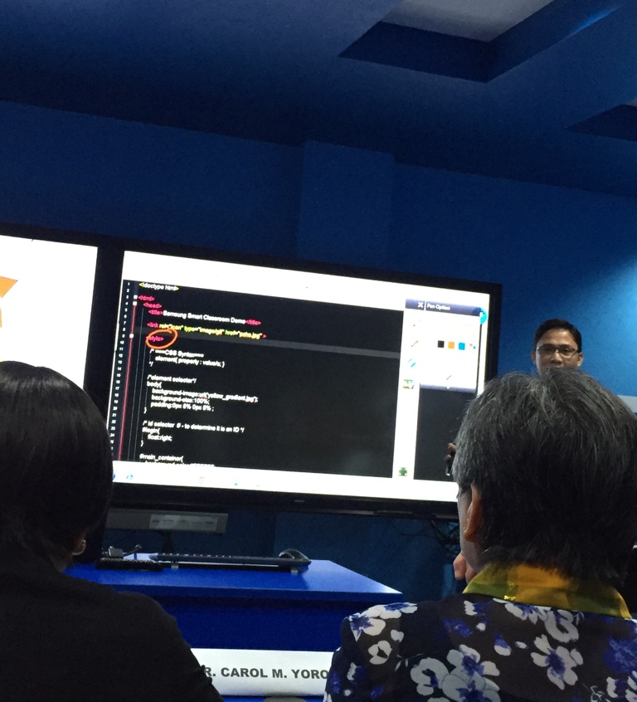
yy
CEBU CAMPUS:
SAMSUNG SMART CLASSROOM
PSHS Foundation Inc. 2017

Slide 24
yy
TRIZ Level 1 WORKSHOP @
MAIN CAMPUS SAMSUNG SMART CLASSROOM
TRIZ (Russian Acronym for Theory of Inventive Problem Solving)
PSHS Foundation Inc. 2017

Slide 25
yy
TRIZ WORKSHOP @
MAIN CAMPUS SAMSUNG SMART CLASSROOM
PSHS Foundation Inc. 2017

Slide 26
yy
MY TRIZ WORKSHOP @
Kuala Lumpur, Malaysia
PSHS Foundation Inc. 2017

Slide 27
yy
MY TRIZ WORKSHOP @
Kuala Lumpur, Malaysia
With Irving Guerrero, ‘71-B, accredited
TRIZ Instructor
PSHS Foundation Inc. 2017

Slide 28
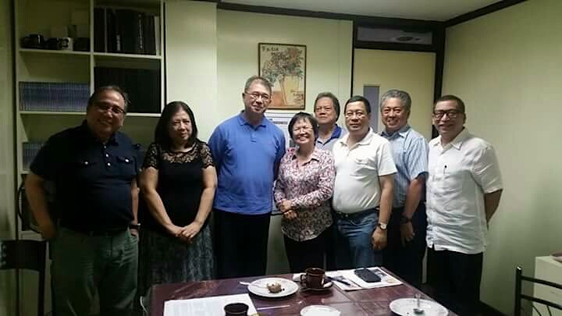
yy
PSHS Board of Trustees, 2016-2017 with Sec. Fortunato dela Pena
PSHS Foundation Inc. 2017

Slide 29
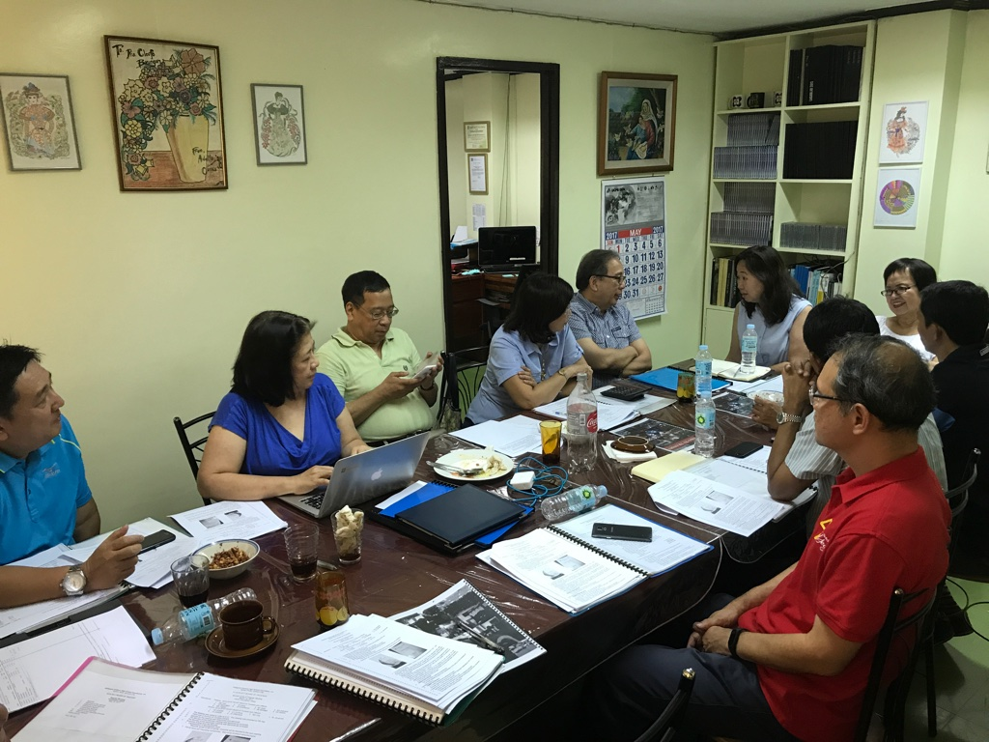
yy
PSHS Board of Trustees, 2016-2017 with Executive Director Lilia Habacon
PSHS Foundation Inc. 2017

Slide 30
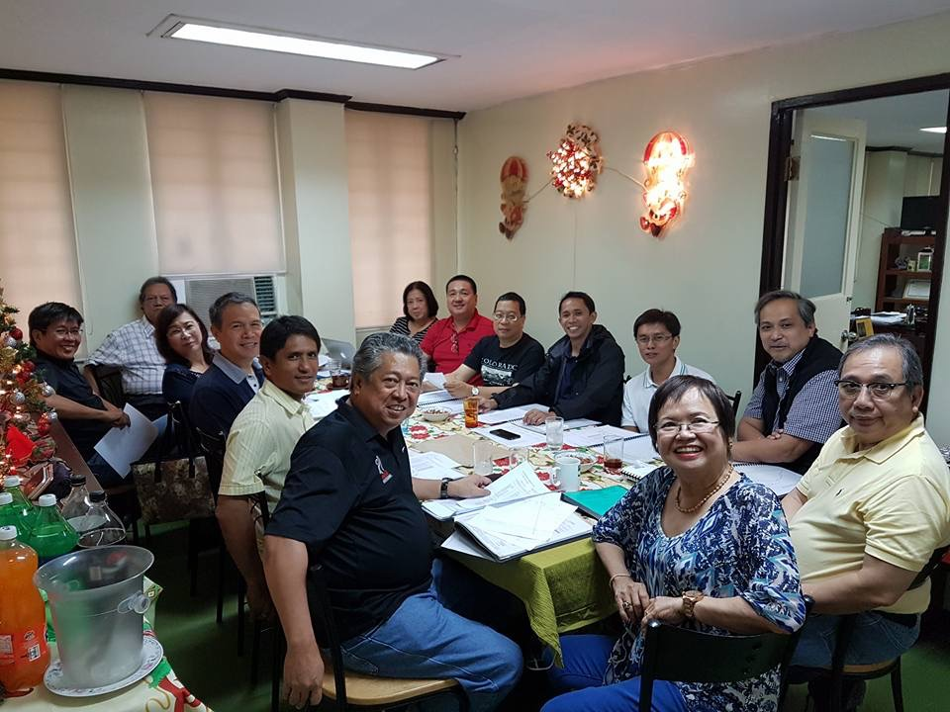
yy
PSHS Board of Trustees, 2016-2017
PSHS Foundation Inc. 2017

Slide 31
yy
THANK YOU!
PSHS Foundation Inc. 2017

